Slide 1
Analyzing the Meaning of words and Sentences

Slide 2
Semantics of English Sentence
The semantics of English sentences refers to the meaning conveyed by the arrangement of words, phrases, and clauses within a sentence.
Word-Level Semantics
Lexical Meaning: Individual words carry inherent meanings
Polysemy and Homonymy: Some words have multiple meanings depending on context
Sentence -level semantics
Compositionality: The meaning of a sentence is derived from the meanings of its parts and the rules used to combine them
Ambiguity:
Lexical Ambiguity: Words with multiple meanings (e.g., "light" as not heavy or illumination).
Structural Ambiguity: Sentence structure leading to multiple interpretations (e.g., "The man saw the woman with a telescope").

Slide 3
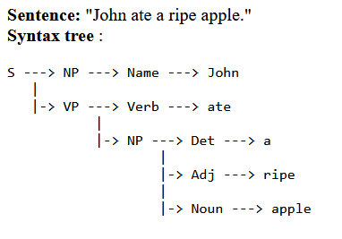
Compositional semantics
Compositional Semantics in Natural Language Processing (NLP) refers to the study and implementation of how the meanings of individual words or phrases combine systematically to determine the meaning of a larger structure, such as a sentence.

Slide 4
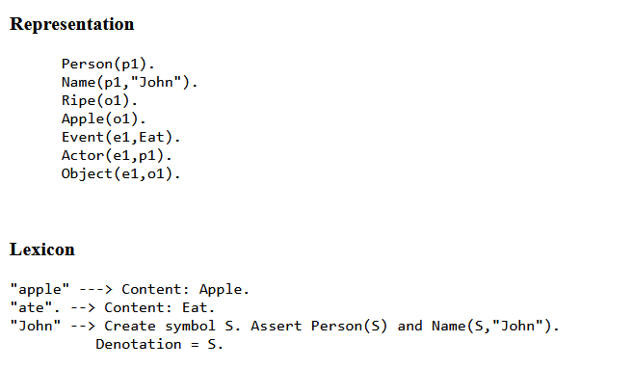

Slide 5
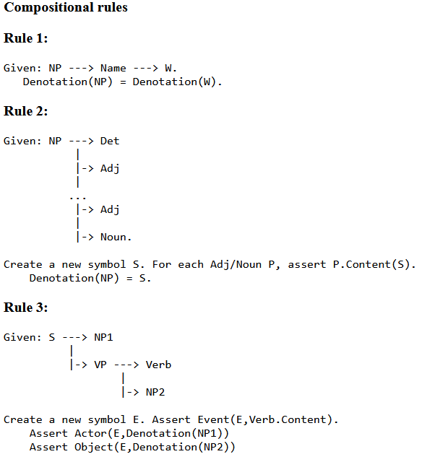

Slide 6
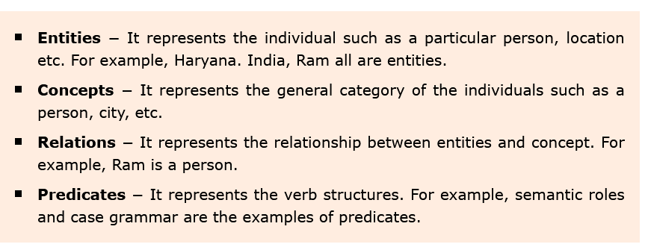
Meaning Representation
Semantic analysis creates a representation of the meaning of a sentence. But before getting into the concept and approaches related to meaning representation, we need to understand the building blocks of semantic system.
Building Blocks of Semantic System

Slide 7
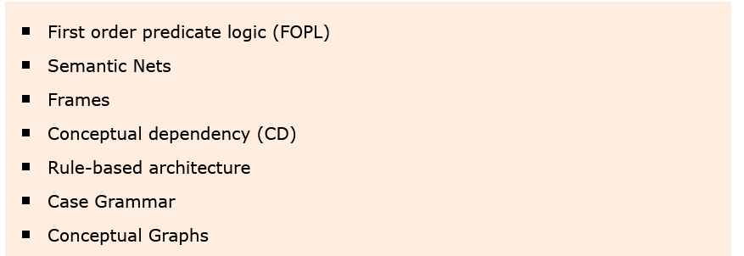
Approaches to Meaning Representations

Slide 8
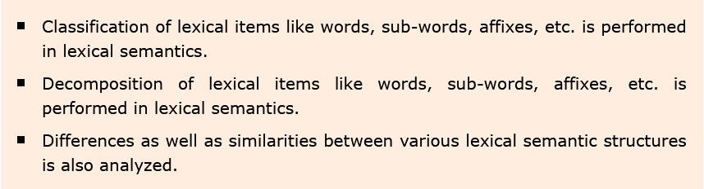
Lexical Semantics
The first part of semantic analysis, studying the meaning of individual words is called lexical semantics. It includes words, sub-words, affixes (sub-units), compound words and phrases also. All the words, sub-words, etc. are collectively called lexical items. In other words, we can say that lexical semantics is the relationship between lexical items, meaning of sentences and syntax of sentence.

Slide 9
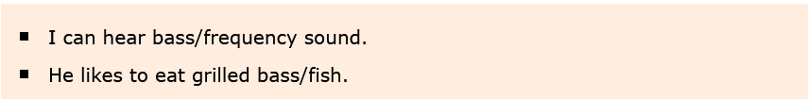
Word sense disambiguation
Word sense disambiguation, in natural language processing (NLP), may be defined as the ability to determine which meaning of word is activated by the use of word in a particular context.
Lexical ambiguity, syntactic or semantic, is one of the very first problem that any NLP system faces. Part-of-speech (POS) taggers with high level of accuracy can solve Word’s syntactic ambiguity.
On the other hand, the problem of resolving semantic ambiguity is called WSD (word sense disambiguation). Resolving semantic ambiguity is harder than resolving syntactic ambiguity.

Slide 10
Evaluation of WSD
The evaluation of WSD requires the following two inputs −
A Dictionary
The very first input for evaluation of WSD is dictionary, which is used to specify the senses to be disambiguated.
Test Corpus
Another input required by WSD is the high-annotated test corpus that has the target or correct-senses.

Slide 11
Approaches and Methods to Word Sense Disambiguation
Dictionary-based or Knowledge-based Methods
Supervised Methods
Semi-supervised Methods
Unsupervised Methods

